Slide 1
Social Statistics
Dr. Sanda Thein (PHD)
Professor
Dept. of Statistics
Yangon University of Economics

Slide 2
Social Statistics
Social Statistics can be defined as the method of collecting, presenting. analyzing and drawing inferences or interpretation of data concerning society and social structure, social and circumstances of people involved.

Slide 3
Nature of Social Statistics
Social Statistics deals with human beings, either as individuals or in various groups,
describing social condition, a very broad coverage which includes certain elements of what are commonly considered as economic statistics, such as income distributions, housing conditions, living standard, cost of social services and
some elements of demography such as life expectancy, infant mortality rates, birth and death rates etc

Slide 4
Sources Social Statistics
These data are collected from three main sources,
(1) Population and housing censuses
(2) Administrative records and registrations and
(3) Social Surveys

Slide 5
Data Collection Methods of Social Statistics
(1) Face-to-face interviews or the personal interviews
(2) Telephone interviews
(3) Combination of techniques

Slide 6
Uses of Social Statistics
social circumstance
policy making and planning of development and other programs for the national and local levels
formulating development plan for economic and social progress.
to evaluate programs, and
to assess the extent to which programs meet planning and other priority needs.

Slide 7
Solving problems
on health, physical growth, education and productivity,
psychological influences on the spending and saving behavior of consumers,
the relationship between religious beliefs and economic or political behaviors,
the effects of different style of supervision on productivity,
the effect of different patterns of child bearing on personality.

Slide 8
to measure the assess the cultural of the community such as cinemas, stage shows, theatres, arts and crafts, sports and libraries etc.

Slide 9
Uses of Employment and Manpower Statistics
to explain the observed level and distribution of income among individuals and households.
to provide information on productive work force
for measuring industrial output and its effect on the structure of the economy.

Slide 10
The labor force data, viewed as an input serve as economic indicators
for monitoring the current performance of the economy and
the changes occurring in the main components of the labor force in relation to other inputs and outputs,
to evaluate government policies and programmed
attentions to the undesirable economic and social conditions - child labor, social and sex biases in work opportunities and participation

Slide 11
the forecasting of future levels of economic activity and forth- coming changes in the industrial structure must rest on a board base of detailed statistics on all aspects of the labor force.
The forecasting may be in connection with national employment programmed reconstructions.

Slide 12
Concept and Definition of Economically Active Population
economically active population comprises all persons of either sex who furnish the supply of labour for the production of economic goods and services during the time-reference period chosen to the investigation. (para. 320, p.43).

Slide 13
Basic Measures of Economic Activity
At Work
Employed
Economically Active Population
Not at Work
Total Population
Unemployed
Economically Inactive Population
Home-makers
Students
Income recipients
Others

Slide 14

Basic Measure of Economic Activity
The volume of economically active population is normally presented in absolute number and as a percentage of the total population.
This is the ratio of economically active population to the total population usually expressed in per cent as follows:
Labour force participation rate (or) Crude Activity rate
= $\frac{Economicaly active population}{Total population}$ $×$ 100

Slide 15
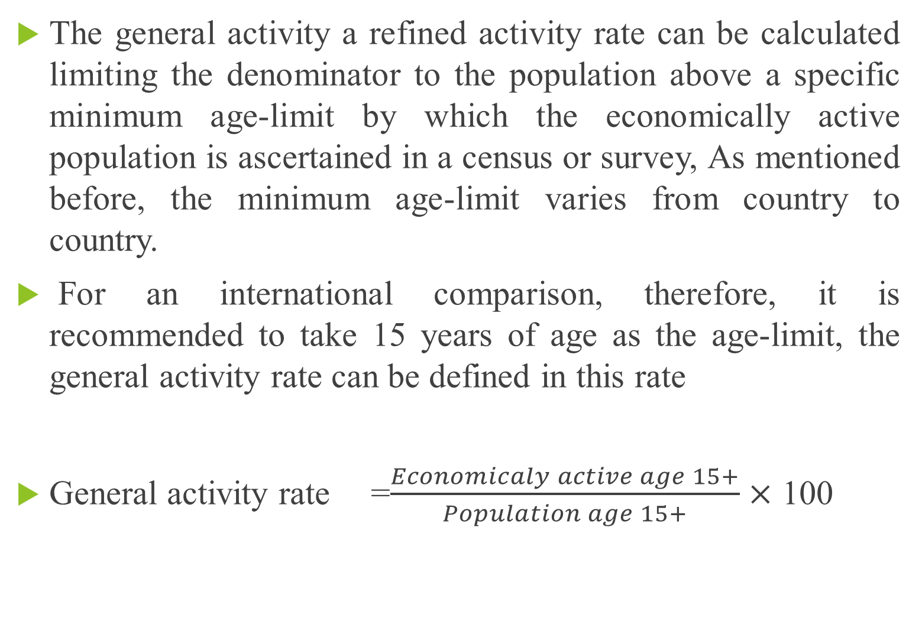
The general activity a refined activity rate can be calculated limiting the denominator to the population above a specific minimum age-limit by which the economically active population is ascertained in a census or survey, As mentioned before, the minimum age-limit varies from country to country.
For an international comparison, therefore, it is recommended to take 15 years of age as the age-limit, the general activity rate can be defined in this rate
General activity rate =$\frac{Economicaly active age 15+}{Population age 15+}$ $×$ 100

Slide 16
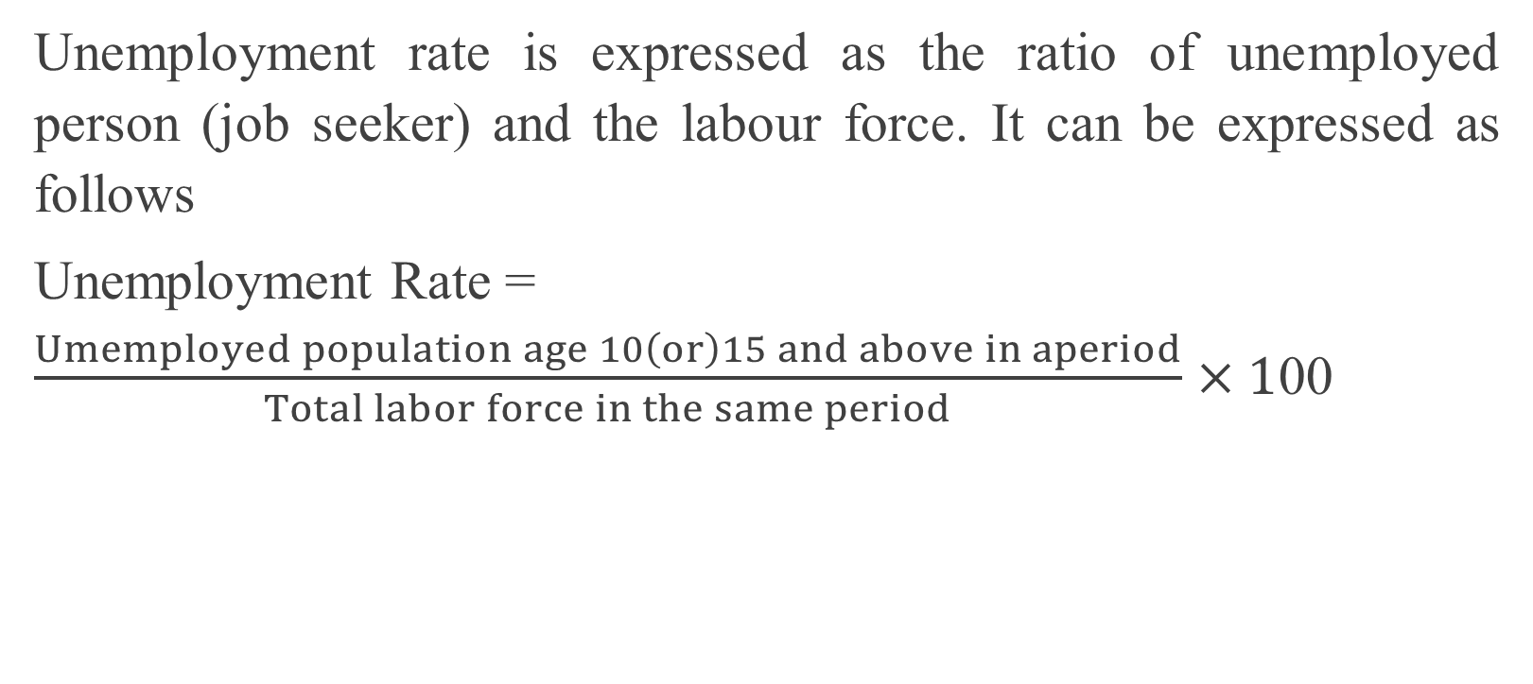
Unemployment Rate
Unemployment rate is expressed as the ratio of unemployed person (job seeker) and the labour force. It can be expressed as follows
Unemployment Rate = $\frac{Umemployed population age 10\left(or\right)15 and above in aperiod}{Total labor force in the same period}$ $×1$00

Slide 17
Uses of Educational Statistics
for compilations, analysis and special studies devoted to the educational system in the country, including past trends, present situation and future trends.
for evaluation, planning, projections.
for formulation development plan for economic and social progress, to skilled manpower and human resources.

Slide 18
Uses of Educational Statistics
Data on school.
Data on teachers
Data on number of pupils by sex
Data on literacy
Data on population according to literacy or educational attainment
Data on school finance

Slide 19
Basic Concepts and Definitions of Education
Literacy
Functionally Literate
Educational Attainment
Educational Qualification

Slide 20
Literacy
Statistics on literacy provide a measure of progress in educational development and are necessary in planning for the promotion of adult literacy.
According to the United Nations, literacy is defined as "the ability both to read and write".
A person is literate who can, with understanding, both read and write a short, simple statement on his everyday life.
A person is illiterate who cannot, with understanding, both read and write a short, simple statement on his everyday life.

Slide 21
Functionally literate
A person is functionally literate who can engage in all those activities in which literacy is required for effective functioning of his group and community and also for enabling him to continue to use reading, writing and calculation for his own and the community's development.

Slide 22
Educational attainment
Educational attainment is defined as "the highest grade completed within the most advanced level attended in the educational system of the country where the education was received".
It is not the number of years spent at school which is counted but the highest grade or level completed in the regular school system.
The term "completed" means the successful completion of a given grade or level based on objective evidence, such as promotion, examination passed, or the possession of a certificate or a diploma.
"Grade" is defined as a stage of instruction usually covered in the course of a school year.

Slide 23
Educational Qualification
Educational qualifications are the qualifications ie degrees, diplomas, certificates and the like, that an individual has acquired, whether by full-time study, part-time study or private study, whether conferred in his home country, or abroad, whether conferred by educational authorities, special examining bodies or professional bodies.
The acquisition of an educational qualification implies the successful compilation of a course of study.

Slide 24
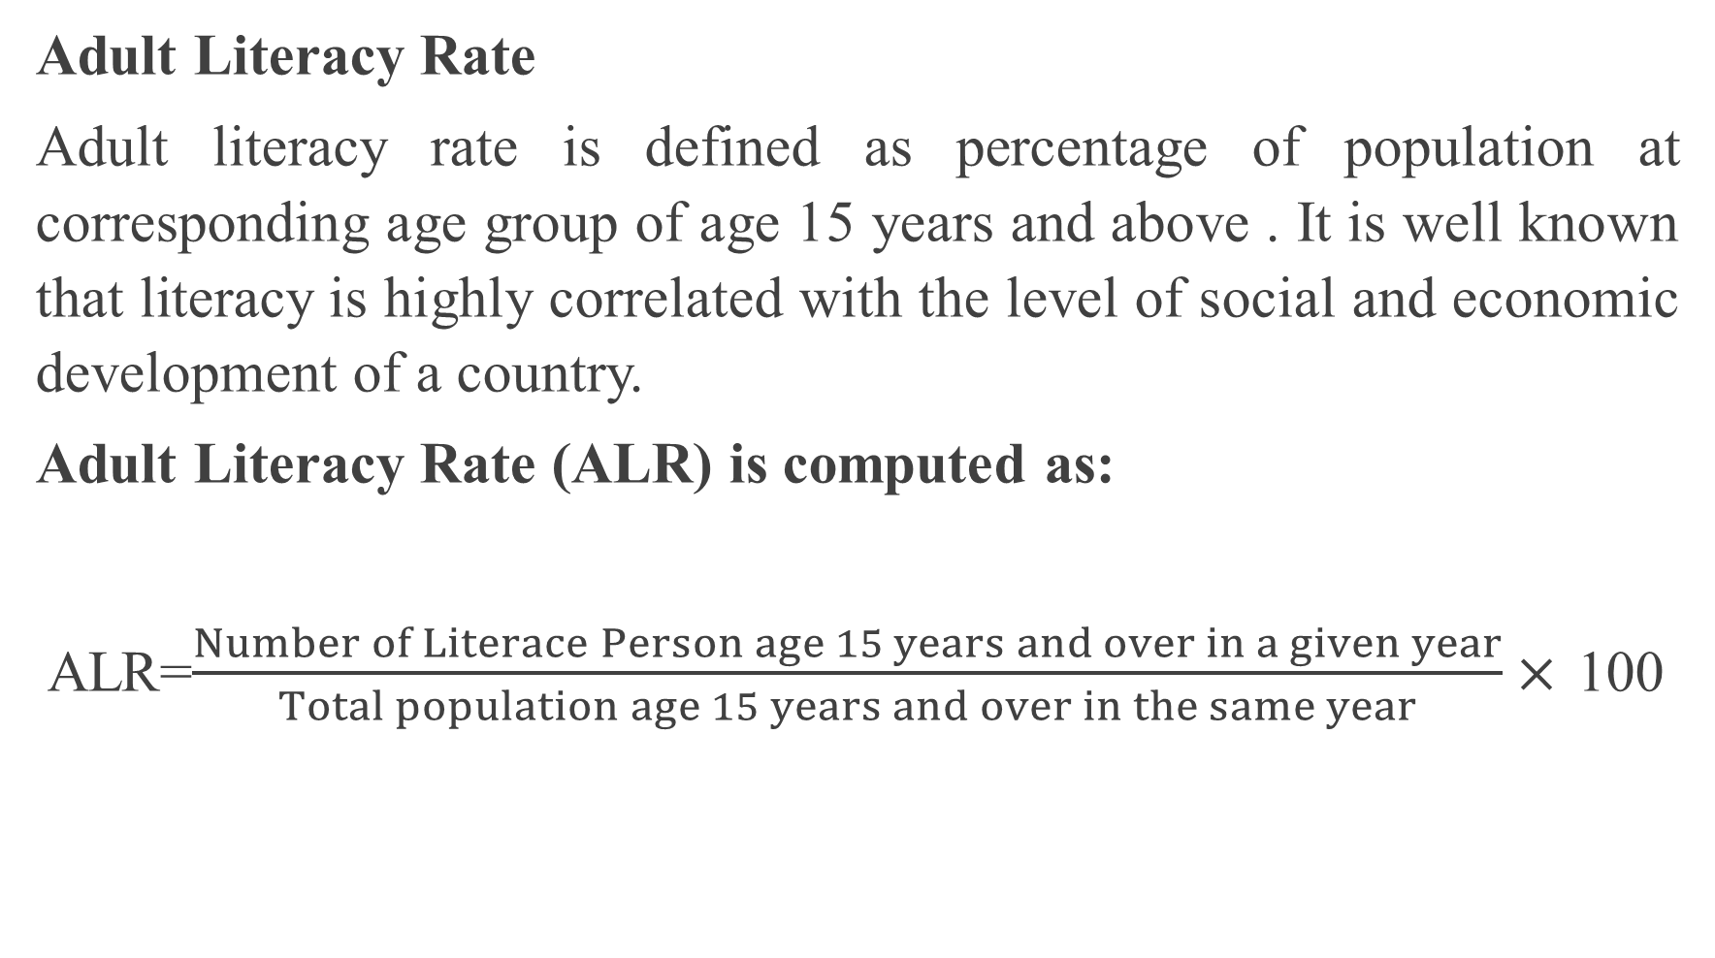
Education Indicators
Adult Literacy Rate
Adult literacy rate is defined as percentage of population at corresponding age group of age 15 years and above . It is well known that literacy is highly correlated with the level of social and economic development of a country.
Adult Literacy Rate (ALR) is computed as:
ALR=$\frac{Number of Literace Person age 15 years and over in a given year}{Total population age 15 years and over in the same year}×$ 100

Slide 25
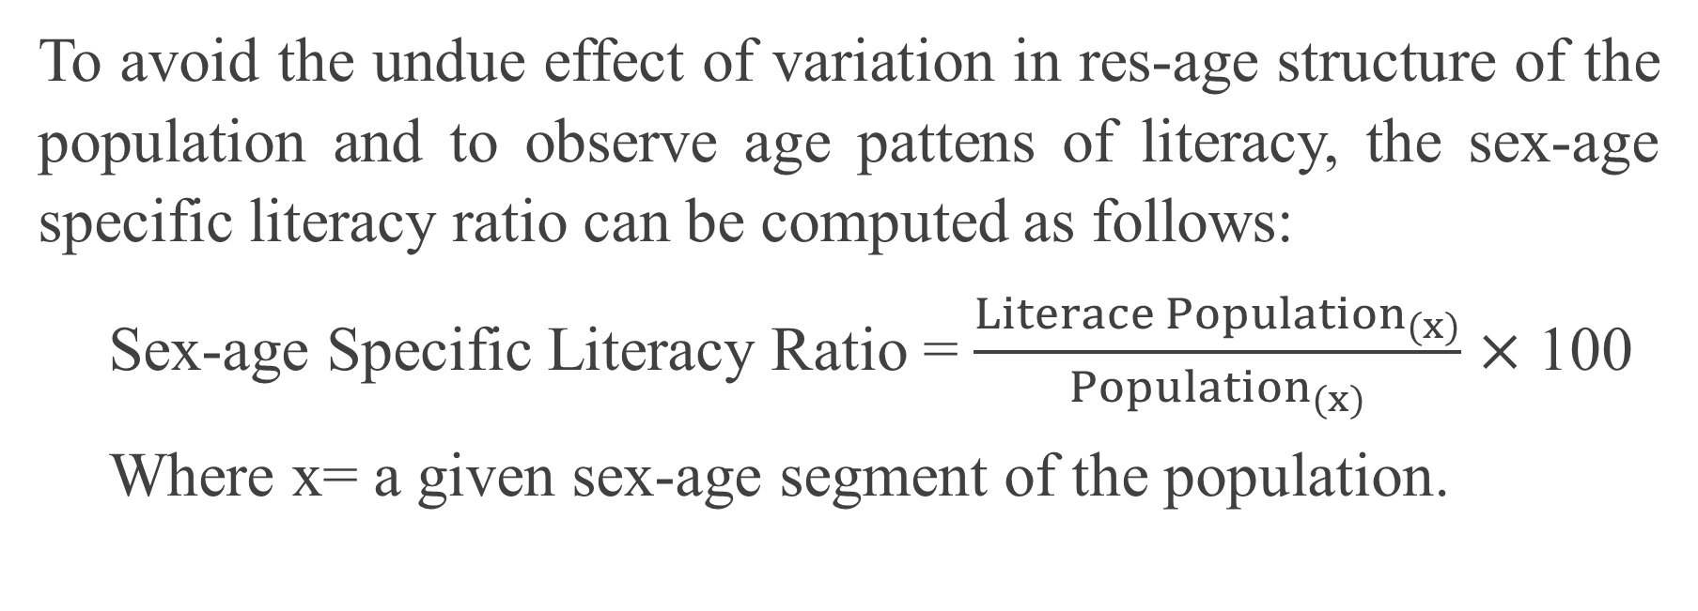
Sex-age Specific Literacy Ratio
To avoid the undue effect of variation in res-age structure of the population and to observe age pattens of literacy, the sex-age specific literacy ratio can be computed as follows:
Sex-age Specific Literacy Ratio = $\frac{Literace {Population}_{(x)}}{{Population}_{(x)}}$ $×$ 100
Where x= a given sex-age segment of the population.

Slide 26
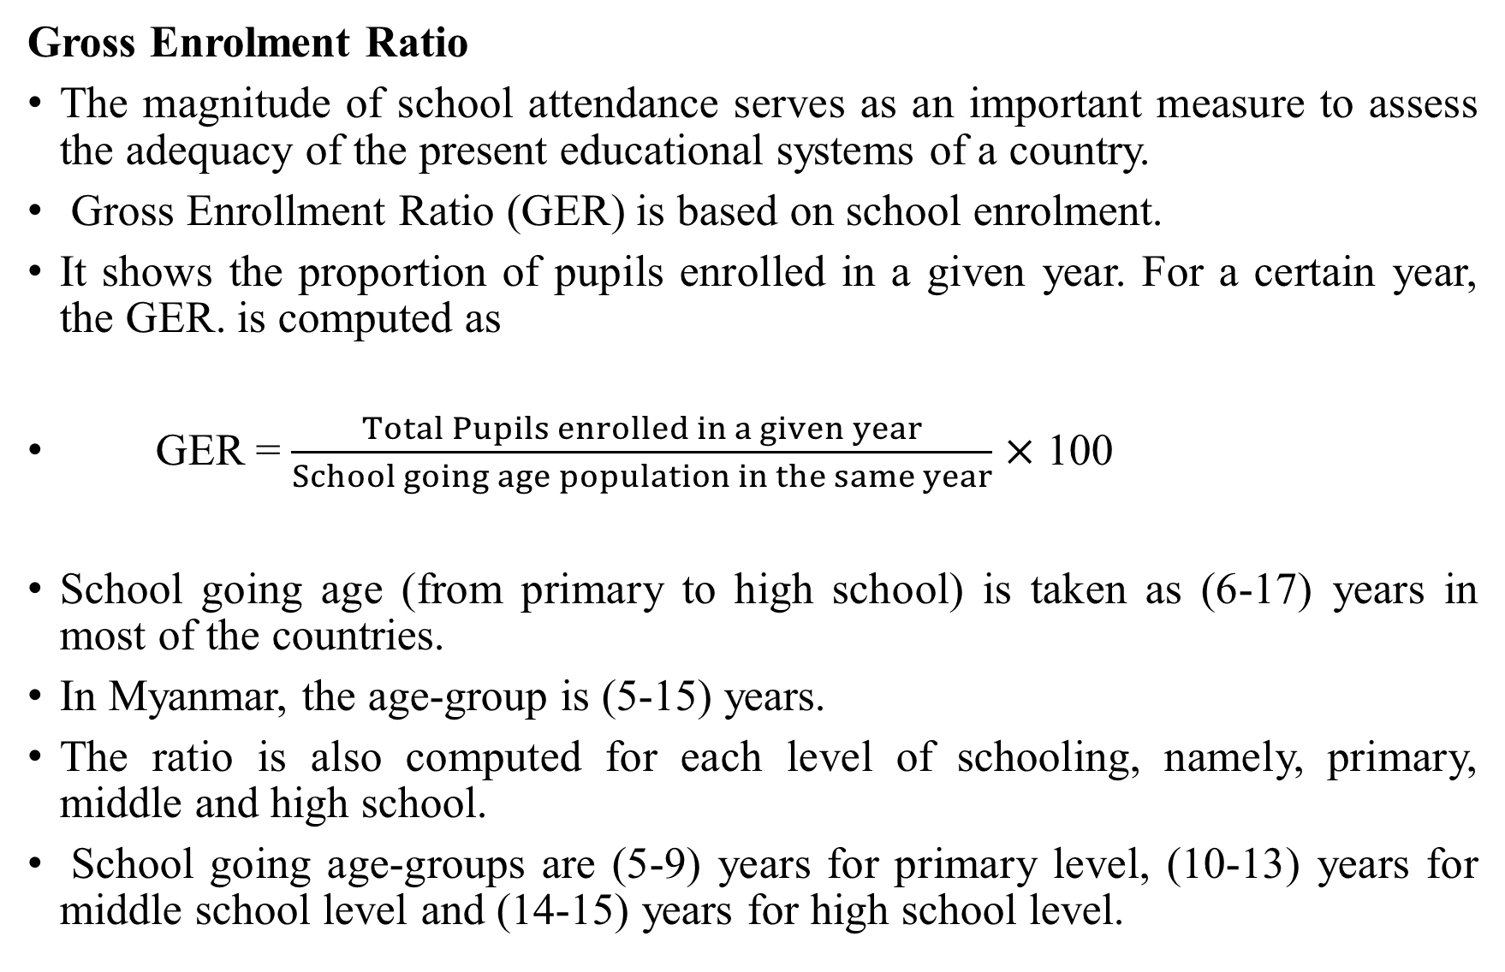
Gross Enrolment Ratio
The magnitude of school attendance serves as an important measure to assess the adequacy of the present educational systems of a country.
Gross Enrollment Ratio (GER) is based on school enrolment.
It shows the proportion of pupils enrolled in a given year. For a certain year, the GER. is computed as
GER = $\frac{Total Pupils enrolled in a given year}{School going age population in the same year}$ $×$ 100
School going age (from primary to high school) is taken as (6-17) years in most of the countries.
In Myanmar, the age-group is (5-15) years.
The ratio is also computed for each level of schooling, namely, primary, middle and high school.
School going age-groups are (5-9) years for primary level, (10-13) years for middle school level and (14-15) years for high school level.

Slide 27
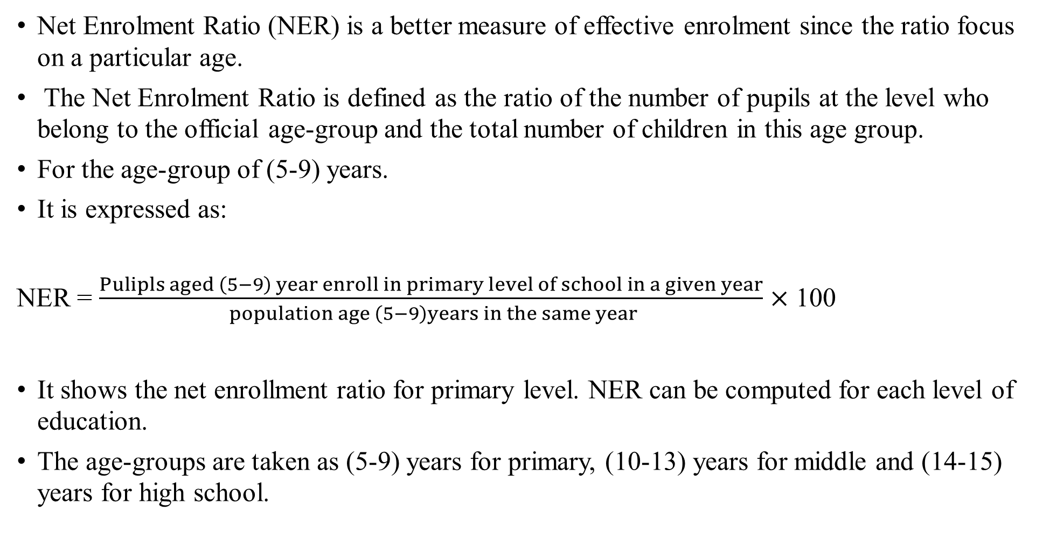
Net Enrolment Ratio
Net Enrolment Ratio (NER) is a better measure of effective enrolment since the ratio focus on a particular age.
The Net Enrolment Ratio is defined as the ratio of the number of pupils at the level who belong to the official age-group and the total number of children in this age group.
For the age-group of (5-9) years.
It is expressed as:
NER = $\frac{Pulipls aged \left(5−9\right) year enroll in primary level of school in a given year}{ population age \left(5−9\right)years in the same year}$ $×$ 100
It shows the net enrollment ratio for primary level. NER can be computed for each level of education.
The age-groups are taken as (5-9) years for primary, (10-13) years for middle and (14-15) years for high school.

Slide 28

Pupil-Teacher Ratio
Pupil-Teacher Ratio was computed to observe the size and workload of the teaching staff.
Pupil-Teacher Ratio = $\frac{S}{T}$
Where S= number of students (pupils)
T=number of teachers

Slide 29

Adjusted Pupil-Teacher Ratio
Adjusted Pupil-Teacher Ratio = $\frac{S×h_{s}}{T×h_{t}}$
Where S=number of students(pupil)
T=number of teachers
$h_{s}$= average learning period per week for a student
$h_{t}$= average teaching period per week for a teacher
The average teaching and learning periods per week prescribed by the Department inf Basic Education are (20 hours fie a SAT and JAT) (28 hours for a PAT) and 35 hours for a primary, middle and high school student.

Slide 30
Basic Measures of Health and Morbid Conditions
the point prevalence rate shows the proportion of sick persons (cases) in the total population at a given moment of time, reflecting the current disease load in the population.
Point prevalence rate(t) = (Number of cases (t)/ Population (t)) x k
Where to the point of time
k=100,000 (occasionally 10,000 or 1,000)

Slide 31
Basic Measures of Health and Morbid Conditions
The point prevalence rate should be clearly distinguished from the incidence rate which is the number of new cases for spells, or persons becoming sick) during a defined reference period of time divided by the mid-period population at risk or the average number of populations at risk during the corresponding period.
Incidence rate(i) = (Number of new cases (i) /Population) x k
Where
ithe reference period of time
Population =the mid-period or average population during the same period
k=1,000 (occasionally 100, 10,000 or 100,000)

Slide 32

Indicator For Health
Population per Doctor (Physician)
In Myanmar physicians are those in the medical sector trained as health professional. The Indicator shows the ratio between population and number of physicians in a given year. Population Per Physician (PPP) is expressed as:
PPP=$\frac{Mid−year population in a given year}{Total number of doctors \left(Physicans\right)in the same year}$

Slide 33

Population per Nursing Personnel
In Myanmar the nursing personnel include all nurses, lady health visitors (LHV) and midwives (MW). The indicator shows the ratio of population and the number of nursing personnel in a given year. Population Per Nursing Personnel (PPNP) is computed as follows:
PPNP=$\frac{Mid−year population in a given year}{Total number of nursing personnel in the same year}$

Slide 34

Population Per Hospital Bed
Population Per Hospital Bed(PPHB) shows the number of population per hospital bed in a given year. The indicator is as follow
PPHB=$\frac{Mid−year population in a given year}{Total number of hospital beds in the same year}$

Slide 35

Number of Villages Per Rural Health Care Centre and Sub-Centre
In Myanmar, it shows the average number of villages served by a rural health care center, both in preventive and curative aspects, in a given year. The rural health care center includes both main center (RHC) and sub-center (sub-RHC): Number of villages per Rural Health care center (NVPRHCC) is.
NVPRHCC = $\frac{Total number of villages in a given year}{Total number of rural health care centers in the same year}$

Slide 36

Percentage of Population Accessible to Safe Drinking Water (PPASDW)
In Myanmar, safe drinking water is defined to be the water obtained from the safe public water, from the tube-well, and from the protected tanks.
Therefore, this indicator can be calculated as the number of persons obtaining safe- drinking water in an area divided by the total population living in the same area for the given period of time.
PPASDW= $\frac{population obtaining safe drinking water in a year}{Total population in the same year}$ $×$ 100

Slide 37
Human Development
human development, it will take into account both the physical and abstract aspects like maturity level, attitudes, habits, behaviour, feelings, intelligence and so on.

Slide 38
Human Development Index
The HDI is based on the three basic components of human development longevity, as measured by life expectancy at birth, educational attainment, as measured by a combination of adult literacy, and combined enrolment ratio, standard of living measured by read GIF per capita (PPP$).
Longevity is measured by life expectancy at birth. Educational attainment is measured by a combination of adult literacy and combined primary, and tertiary ratio. Stranded of living is measured by purchasing power, hated on real GDP per capital adjusted for the cost of living.

Slide 39
Human Resources Development
A good quality of population is very important in determining the level of economic growth.
the investment in human capital in the form of educational and medical and such other social schemes is very much desirable.
Human resource development increases the knowledge, the skills and the capabilities of the people that increase their productivity.

